Slide 1

CTI 4.HAFTA
SKY-SEC Bootcamp

Slide 2
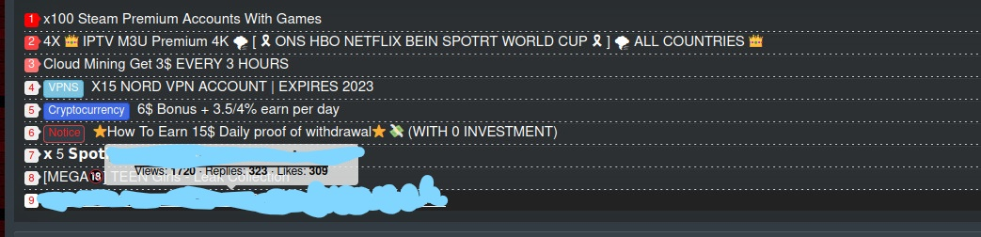
Forum siteleri

Slide 3
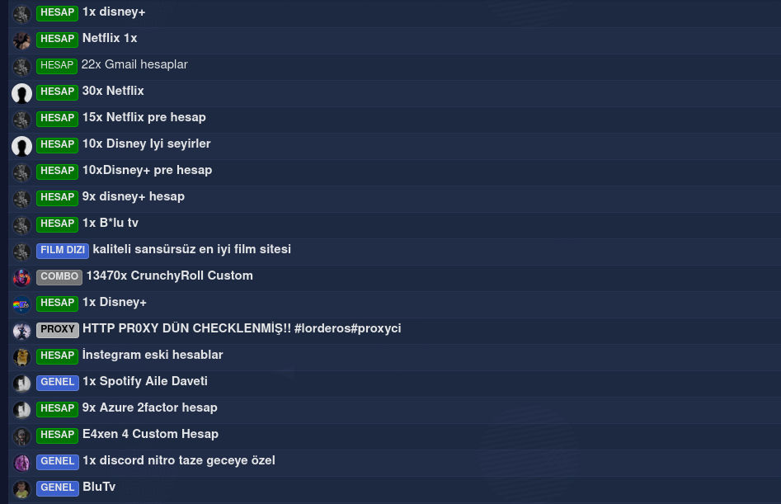
Forum siteleri

Slide 4
Database
http://visualgenome.org/

Slide 5
Translation
https://www.newocr.com/

Slide 6
Archive
https://archive.is/
https://archive.org/
http://timetravel.mementoweb.org/

